Slide 1
e-commerce website to sell the Food Item
JFSD & EP
2010030455 K Manichand
2010030358 B Avinash
2010030421 V Rithvik

Slide 2
INTRODUCTION
Online Grocery Store is an eCommerce based web application for our Web Programming project.
We will develop a sample in which user can search and find necessary information about any grocery item, can proceed to checkout to buy products.
User can create an account, update personal information, can check its past activities, orders and transactions, and cart items.

Slide 3
ABSTRACT
An online Grocery Store permits a customer to submit online orders for items and/or services from a store that serves both walk-in customers and online customers .
The online Store system presents an online display of all the items they want to sell .
This web based application helps customers to choose their daily needs and add products to their shopping cart.
Customers provides their complete detail of address and contact and they get their chosen products in their home . This Web application saves lots of time of customers.

Slide 4
Literature Survey
TITLE | AUTHOR | PUBLISHED YEAR | SUMMARY
Consumer response to online grocery shopping | Michelle A. Morganosky and Brenda J. Cude | 2020 | objective is to profile the characteristics of such users and make a preliminary assessment of consumer response to, and demand for, online grocery shopping services based on behavioral data.
Online grocery shopping: the influence of situational factors | Chris Hand, Francesca Dall’ Olmo Riley, Patricia Harris | 2018 | This paper seeks to understand the triggers which influence the adoption (and the discontinuation) of online grocery shopping. Specifically, the research aims to establish the role of situational factors in the process of adoption
The Acceptance of Online Grocery Shopping | Sherah Kurnia, Ai-Wen Jenny Chien | 2019 | The findings of the study have demonstrated the applicability of the Technology Acceptance Model in assessing the acceptance of Online Grocery Shopping in Australia , as an example of B2C electronic commerce enabled technology application.
Creating customer value in online grocery shopping | Bill Anckar Pirkko Walden and Tawfik Jelassi | 2020 | This paper argues that there are four different ways in which customer value can be created in electronic grocery shopping, but that the chosen business model will set limits to whether and to what extent the firm will be able to offer value-adding services for consumers

Slide 5
Technique Used in this Project
Language:
Backend:-Java
Frontend.-html , CSS and Javascript
database.- MYSQL
IDE:-
eclipse
Visual studio code
Connectivity.
JDBC connector

Slide 6
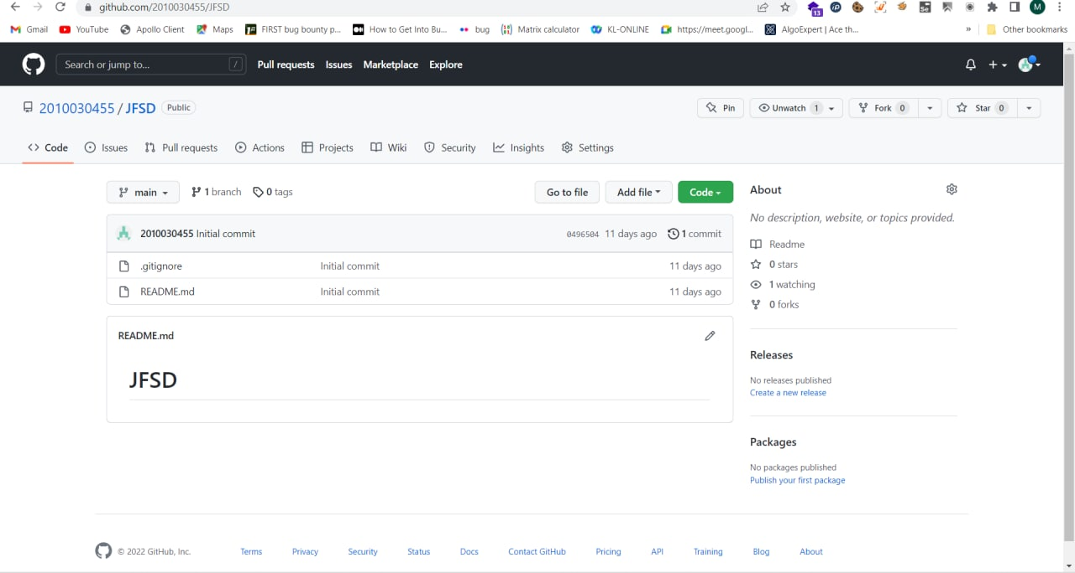
Github:

Slide 7
CONCLUSION
The Grocery Store Management System is a system
designed for managing i.e. for ordering, arranging
and selling goods
Where retailer will sell their food item and customers will buy

Slide 8
REFERENCES
https://www.researchgate.net/profile/Brenda-Cude/publication/235317432_Consumer_Response_to_Online_Grocery_Shopping/links/57aa11af08ae0932c96e5c04/Consumer-Response-to-Online-Grocery-Shopping.pdf
https://www.dhi.ac.uk/san/waysofbeing/data/economy-crone-hand-2009.pdf
https://citeseerx.ist.psu.edu/viewdoc/download?doi=10.1.1.529.7050&rep=rep1&type=pdf
https://www.researchgate.net/profile/Pirkko-Walden/publication/31594479_Creating_Customer_Value_in_Online_Grocery_Shopping/links/5ece649992851c9c5e5f948b/Creating-Customer-Value-in-Online-Grocery-Shopping.pdf

Slide 9
THANK YOU

